Slide 1
22C:19 Discrete Structures Integers and Modular Arithmetic
Spring 2014
Sukumar Ghosh

Slide 2
Preamble
Historically, number theory has been a beautiful area of
study in pure mathematics. However, in modern times,
number theory is very important in the area of security.
Encryption algorithms heavily depend on modular
arithmetic, and our ability (or inability) to deal with large integers. We need appropriate techniques to deal with such algorithms.

Slide 3
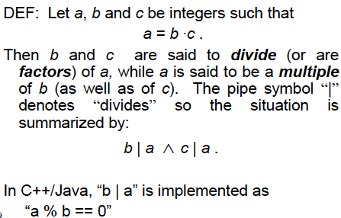
Divisors

Slide 4
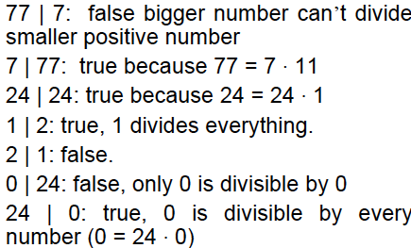
Examples

Slide 5
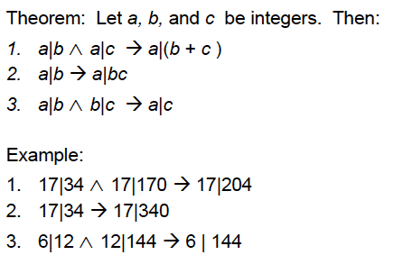
Divisor Theorem

Slide 6
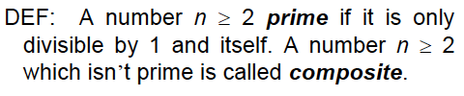

Prime Numbers

Slide 7
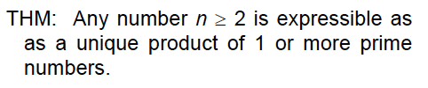

A theorem

Slide 8

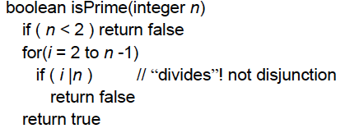
Testing Prime Numbers

Slide 9

Time Complexity
The previous algorithm has a time complexity O(n)
(assuming that a|b can be tested in O(1) time).
For an 8-digit decimal number, it is thus O(10⁸).
This is terrible. Can we do better?
Yes! Try only smaller prime numbers as divisors.

Slide 10


Primality testing theorem
Proof (by contradiction). Suppose the smallest prime factor p is greater than
Then n = p.q where q > p and p >
This is a contradiction, since the right hand side > n.

Slide 11
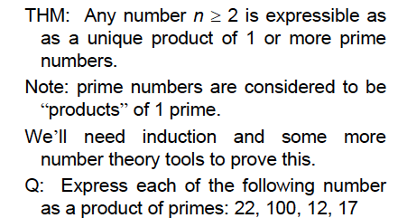
A Fundamental Theorem

Slide 12
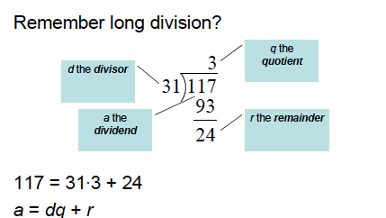
Division

Slide 13
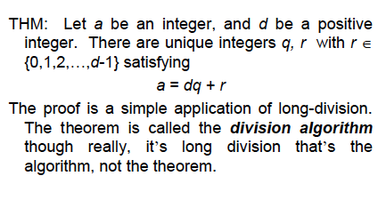
Division

Slide 14
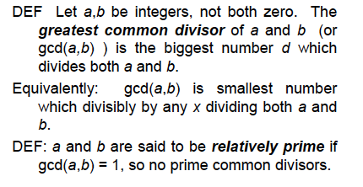
Greatest Common Divisor

Slide 15
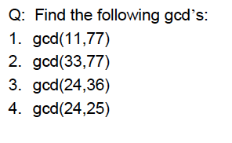
Greatest Common Divisor
Q: Compute gcd (36, 54, 81)

Slide 16
Euclid’s gcd Algorithm
procedure gcd (a, b)
x:= a; y := b (x>y)
while y ≠ 0
begin
r:= x mod y
x:= y
y:= r
end
The gcd of (a, b) is x.
Let a = 12, b= 21
gcd (21, 12)
= gcd (12, 9)
= gcd (9, 3)
Since 9 mod 3 = 0
The gcd is 3

Slide 17
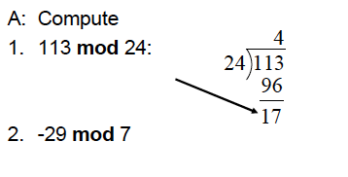
The mod Function

Slide 18
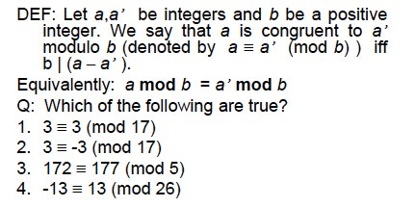
(mod) Congruence

Slide 19
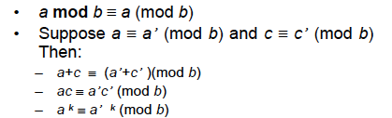
(mod) Congruence

Slide 20
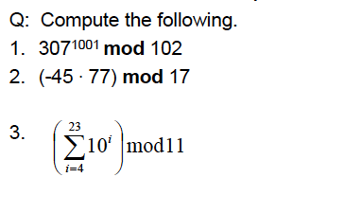
Modular Arithmetic: harder examples

Slide 21
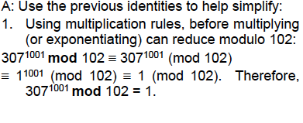
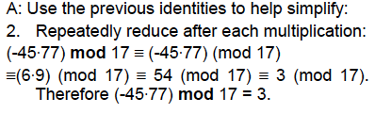
Modular Arithmetic: harder examples

Slide 22
Linear Congruence
A linear congruence is of the form
ax ≡ b (mod m)
Where a, b, m are integers, and x is a variable.
To solve it, find all integers that satisfy this congruence
For example, what is the solution of 3x ≡ 4 (mod 7)?
First, we learn about the inverse.

Slide 23
The Inverse
a mod m has an inverse a', if a.a’ ≡ 1 (mod m).
The inverse exists whenever a and m are relatively prime,
i.e. gcd (a, m) = 1.
Example. What is the inverse of 3 mod 7?
Since gcd (3, 7) = 1, it has an inverse.
The inverse is -2

Slide 24
Solution of linear congruences
Solve 3x ≡ 4 (mod 7)
First, compute the inverse of 3 mod 7. The inverse is -2.
(-6 mod 7 = 1 mod 7)
Multiplying both sides by the inverse,
-2. 3x = -2.4 (mod 7) = -8 (mod 7)
x = -8 mod 7 = -1 mod 7 = 6 mod 7 = ..

Slide 25
Chinese remainder theorem
In the first century, Chinese mathematician Sun-Tsu asked:
Consider an unknown number x. When divided by 3 the remainder is 2, when
divided by 5, the remainder is 3, and when divided by 7, the remainder is 2.
What is x?
This is equivalent to solving the system of congruences
x ≡ 2 (mod 3)
x ≡ 3 (mod 5)
x ≡ 2 (mod 7)

Slide 26
Chinese remainder theorem
Let m₁, m_{2,} m₃, …m_{n} be pairwise relatively prime integers, and
a₁, a₂,…, a_{n} be arbitrary integers. Then the system of equations
x ≡ a₁ (mod m₁)
x ≡ a₂ (mod m₂)
... … … …
x ≡ a_{n} (mod m_{n})
has a unique solution modulo m = m₁ m₂ m₃ ... m_{n}
[It is x = a₁ M₁ y₁ + a₂ M₂ y₂ + ... + a_{n} M_{n} y_{n},
where M_{k} = m/m_{k} and y_{k} = the inverse of M_{k} mod m_{k}]

Slide 27
Fermat’s Little Theorem
Compute 7²²² (mod 11)
7²²² (mod 11) = (7¹⁰)²² . 7² (mod 11)
7¹⁰ (mod 11) =1 (Fermat’s little theorem)
7²²² (mod 11) = 1²².49 (mod 11) = 49 (mod 11) = 5 (mod 11)

Slide 28
Fermat’s Little Theorem
If p is prime and a is an integer not divisible by p, then
a^{p-1} = 1 (mod p)
This also means that a^{p} = a (mod p)

Slide 29
More on prime numbers
Are there very efficient ways to generate prime numbers?
Ancient Chinese mathematicians believed that n is a prime
if and only if
2^{n-1} = 1 (mod n)
For example 2⁷⁻¹ = 1 (mod 7) (and 7 is a prime)
But unfortunately, the “if” part is not true. Note that
2³⁴¹⁻¹ = 1 (mod 341),
But 341 is not prime (341 = 11 X 31).
(these are called pseudo-prime numbers).
When n is composite, and b^{n-1} = 1 (mod n), n is called a pseudo-prime to the base b

Slide 30
Applications of Congruences
Hashing function
A hashing function is a mapping
key ➞ a storage location
(larger domain) (smaller size storage)
So that it can be efficiently stored
and retrieved.
0
1
2
m-2
m-1

Slide 31
Applications of Congruences
Hashing function
Assume that University of Iowa plans to maintain a record of its 5000 employees using SSN as the key. How will it assign a memory location to the record for an employee with key = k? One solution is to use a hashing function h:
h(k) = k² mod m
(where m = number of available memory locations)
0
1
2
m-2
m-1

Slide 32
Hashing functions
A hashing function must be easy to evaluate, preferably in constant (i.e O(1) )time. There is a risk of collision (two keys mapped to the same location), but in that case the first free location after the occupied location has to be assigned by the hashing function.
0
1
2
Key k1
Key 2
m-2
m-1

Slide 33
Parity Check
When a string of n bits b₁ b₂ b₃ … b_{n} is transmitted, sometimes a single bit is corrupted due to communication error. To safeguard this, an extra bit b_{n+1} is added. The extra bit is chosen so that mod 2 sum of all the bits is 0.
1 1 0 1 0 1 0
0 1 0 1 1 0 0 1 1 1 (parity bit in red)
Parity checking helps detect such transmission errors. Works for singe bit corruption only

Slide 34
Private Key Cryptography
The oldest example is Caesar cipher used by Julius Caesar to
communicate with his generals.
For example, LOVE ➞ ORYH (circular shift by 3 places)
In general, for Caesar Cipher, let
p = plain text c= cipher text, k = encryption key
The encryption algorithm is c = p + k mod 26
The decryption algorithm is p = c - k mod 26
Both parties must share a common secret key.

Slide 35
Private Key Cryptography
One problem with private key cryptography is the distribution of the private key. To send a secret message, you need a key. How would you transmit the key? Would you use another key for it?
This led to the introduction of public key cryptography

Slide 36
Public Key encryption
RSA Cryptosystems uses two keys, a public key and a private key
Let n = p . q (p, q are large prime numbers, say 200 digits each)
The encryption key e is relatively prime to (p-1)(q-1), and
the decryption key d is the inverse of e mod (p-1)(q-1)
(e is secret, but d is publicly known)
Ciphertext C = Me mod n
Plaintext M = C^{d} mod n (Why does it work?)
Ciphertext C is a signed version of the plaintext message M.
Or, Alice can send a message to Bob by encrypting it with Bob’s public key.
No one else, but Bob will be able to decipher it using the secret key

Slide 37
Public Key encryption
Ciphertext C = Me mod n
Plaintext M = C^{d} mod n
When Bob sends a message M by encrypting it with his secret key e,
Alice (in fact anyone) can decrypt it using Bob’s public key. C is a
signed version of the plaintext message M.
Alice can send a message to Bob by encrypting it with Bob’s public key
d. No one else, but Bob will be able to decipher it using his secret key e

Slide 38
Example
n = 43 x 59 = 2537 (i.e. p = 43, q = 59). Everybody knows n. but nobody knows p or q – they are secret.
(p-1)(q-1) = 42 x 58 = 2436
Encryption key e = 13 (must be relatively prime with 2436) (secret).
Decryption key d = 937 (is the inverse of e mod (p-1)(q-1)) (public knowledge)
Encrypt 1819: 1819¹³ mod 2537 = 2081
Decrypt 2081: 2081⁹³⁷ mod 2537 =1819

Slide 39
Proof of RSA encryption
Ciphertext C = Me mod n
C^{d} = Mde = M^{1+k(p-1)(q-1)} mod n (Here n = p.q)
(since d is the inverse of e mod (p-1)(q-1), de = 1 mod (p-1)(q-1)
= M .(M^{(p-1)})^{k(q-1)} mod n
Since gcd (M, p) = 1 C^{d} = M.1 mod p (Using Fermat’s Little Theorem)
Similarly, C^{d} = M.1 mod q
Since gcd(p,q) = 1, C^{d} = M.1 mod p.q (Chinese Remainder Theorem)
So, C^{d} = M mod n

